Slide 1
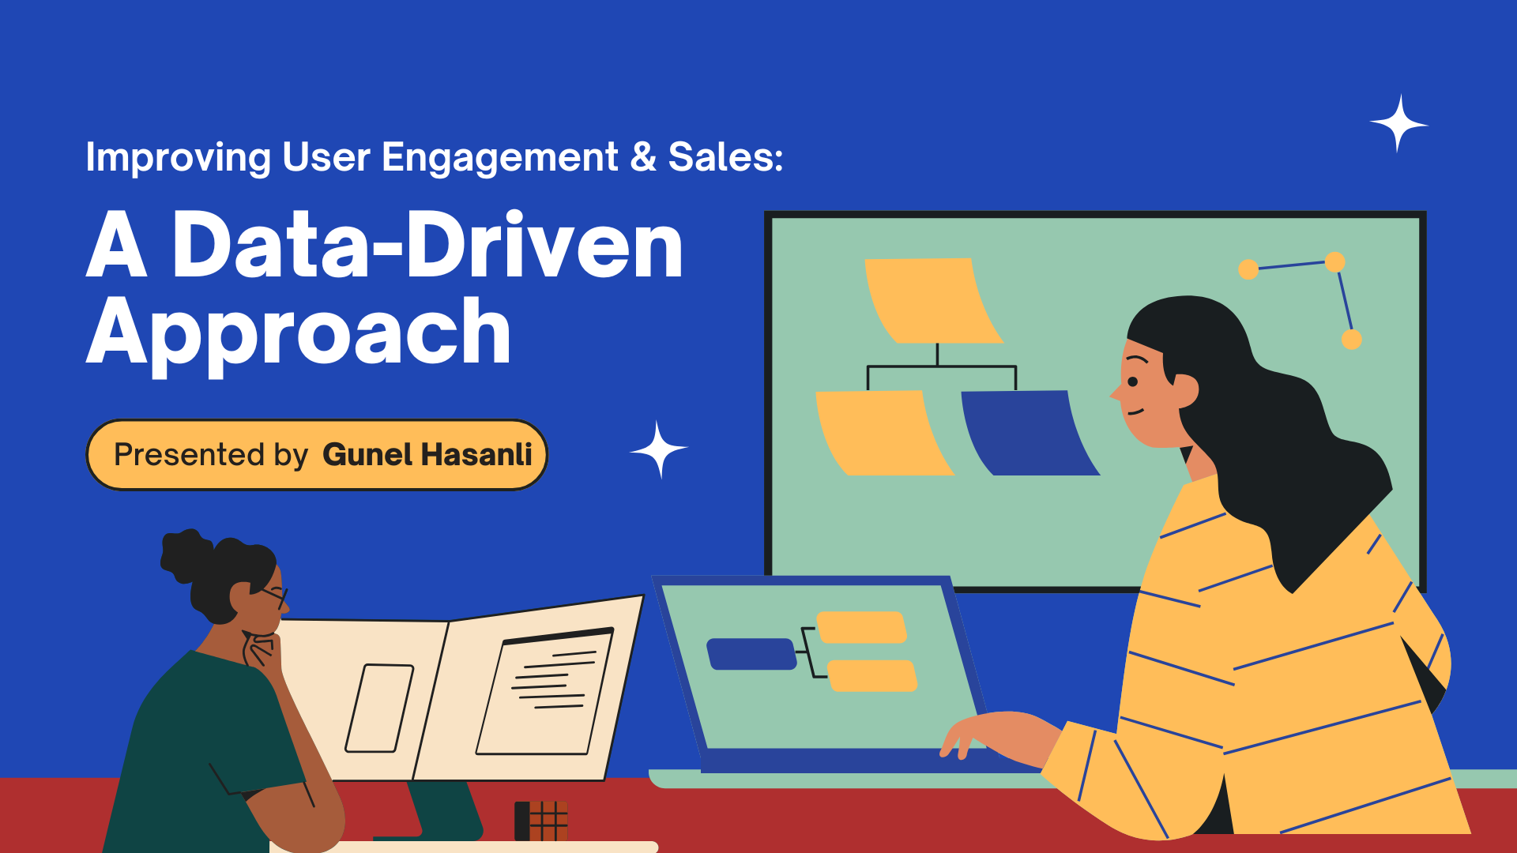

Slide 2
Situation Description An educational online platform is experiencing a problem: a high conversion rate at the registration stage (60% of all visitors register), but a low conversion to purchase (only 5% of registered users make a purchase).
Available Data:
● Average session duration of registered users: 4 minutes
● Most viewed pages: course catalog, specific course page, payment page
● 75% of users leave the site on the payment page
● 65% of users visit the platform only once after registration

Slide 3
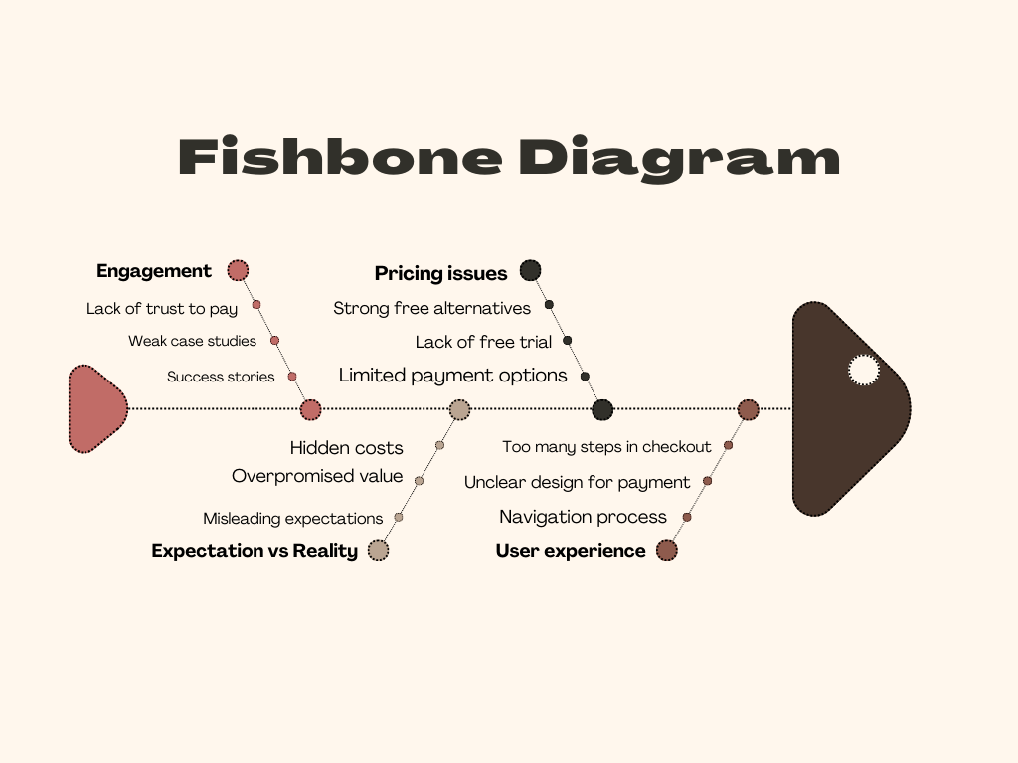
Ishikawa (Fishbone) Diagram

Slide 4

5 Whys Analysis: Why Is the Conversion Rate from Registration to Purchase Low?
1️. Why are registered users not making purchases? 👉 They face obstacles in the payment process or don’t see enough value in purchasing.
2️. Why do they face obstacles or not see value? 👉 The platform has poor UX navigation, unclear pricing, misleading expectations, and lack of engagement.
3.️ Why is the UX navigation poor and expectations misleading? 👉 The payment process is not intuitive, users expect free content.
4. Why is the platform not guiding users properly or setting correct expectations? 👉 The team lacks expertise in design and effective communication strategies.
5️. Why does the team lack expertise in these areas? 👉 There is insufficient investment in research, A/B testing, and marketing alignment.

Slide 5

What to do?
🚀 Solutions to Improve Conversion & Retention
1. Pricing & Value Communication
✅ Clearly differentiate Free vs. Paid content. ✅ Use Decoy Pricing (Basic, Premium, VIP) for guided decisions. ✅ A/B Test one-time payments vs. subscriptions.
Here’s how it works:
Group A sees a one-time payment option (e.g., "Pay $100 once for lifetime access").
Group B sees a subscription model (e.g., "Pay $10 per month").
By comparing which option leads to more purchases and higher revenue, the platform can choose the best payment method for its users.
2. Social Proof & Trust Building
✅ Show AI-powered testimonials relevant to each user. ✅ Display real-time purchases (FOMO effect). (e.g., “5 people bought this course in the last hour!”)
✅ Use data-backed case studies (e.g., "90% of users improved skills in 3 months").

Slide 6
3. Smart Free Trial & Freemium Model ✅ Gamified trials – users unlock content by completing small tasks. ✅ "Earn Your Discount" – engagement unlocks exclusive offers. (e.g, Watch a free demo video → Receive a 15% discount code.) 4. Reducing Payment Page Drop-offs (75% Exit!) ✅ If a user tries to leave the payment page, a pop-up appears with a discount. (e.g, “Wait! Get 10% off if you complete your purchase now!”) ✅ Add live chat support on the payment page. 5. Boosting Retention (65% Users Visit Only Once!) ✅ Behavior-based emails – personalized re-engagement. ✅ Push notifications – smart reminders based on user activity.
📌 Results Expected:
✔ Increased conversion from registration to purchase 📈 ✔ Higher user engagement & repeat visits 🔄 ✔ Reduced drop-off at payment stage 💳

